Slide 1
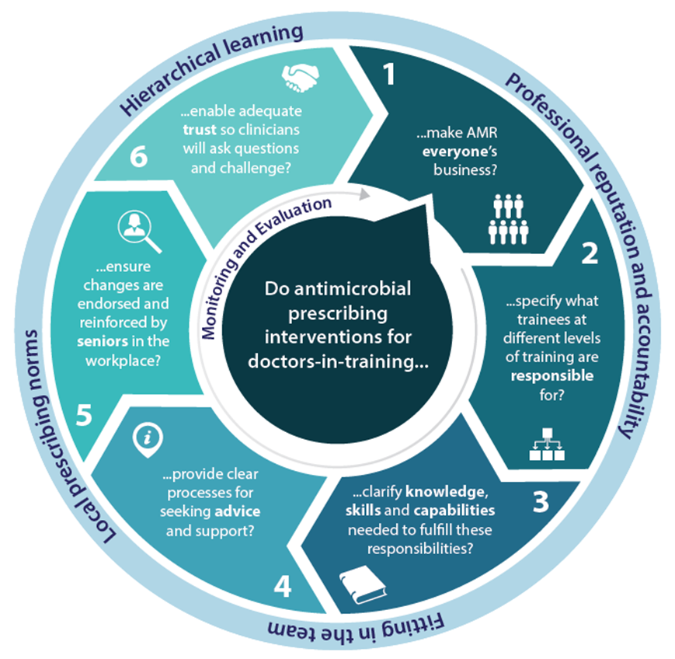
Improving antimicrobial prescribing of doctors-in-training: Does realist review give insight into systemic implementation issues?
Chrysanthi Papoutsi,¹ Nicola Brennan,² Simon Briscoe,³ Karen Mattick,⁴ Mark Pearson,⁵ Geoff Wong,¹ ¹ Nuffield Department of Primary Care Health Sciences, University of Oxford ² Collaboration for the Advancement of Medical Education Research & Assessment (CAMERA), Peninsula Schools of Medicine & Dentistry, Plymouth University ³ Evidence Synthesis & Modelling for Health Improvement (ESMI), University of Exeter Medical School ⁴ Centre for Research in Professional Learning, Graduate School of Education, University of Exeter ⁵ NIHR CLAHRC South West Peninsula, Institute of Health Research, University of Exeter Medical School
1. Background
To date behavioural change antimicrobial prescribing interventions have had variable levels of success (for more details see [1]). It s increasingly recognised that social norms and informal influences affect prescribing behaviour [2].
Our realist review aims to understand how antimicrobial prescribing interventions produce their effects, by taking into account the wider contexts in which prescribing decisions are negotiated. The review particularly focuses on doctors-in-training as they are numerically the largest group of prescribers in the hospital setting [3] and a key part of future prescribers.
3. Decision-support principles for designing and tailoring antimicrobial prescribing interventions
4. Does realist review give insight into systemic implementation issues?
Implementation is a process rather than an outcome, and interventions incorporate ‘bundles’ of ways of thinking, acting, and organising [7]. To understand implementation we need to understand the intervention - how, why, for whom, in what contexts, and to what extent does it ‘work’? In other words, we need to gain contextualised-insights into how people mobilise resources and act collectively (or not) [8].
How did realist review enable us to get insight?
It provided an in-depth explanation of prescribing behaviours, by:
Integrating research findings with stakeholders’ understandings, interpretations, and knowledge.
Linking refined programme theory to existing social theory.
It enabled us to develop actionable findings for different situations, by:
Explicitly considering the impact of context (in the form of context-mechanism-outcome configurations).
‘Working with’ complexity rather than trying to ‘control it out’.
Flexibility, which enabled us to judiciously engage with stakeholders in the most appropriate and timely way (e.g. individual discussions as well as stakeholder meetings).
2. Methods
Our review’s protocol has been published in [4]. The review follows current quality and publication standards [5, 6].
A realist review is an interpretive, theory-driven approach to synthesizing evidence from qualitative, quantitative and mixed-methods research. Its main strength lies in producing findings that coherently explain how and why mechanisms triggered in different contexts influence outcomes.
Initial programme theory drawing on informal literature searching and discussions between the project team.
Iterative databases search; title/abstract screening 10% sample compared with second reviewer.
Programme theories refined through consultation with group of stakeholders (patients and health professionals - 4 x 2 hour meetings), discussions between the context experts of the team, and analysis of the data from published literature (n=131).
5. References
Brennan, N., & Mattick, K. (2013). A systematic review of educational interventions to change behaviour of prescribers in hospital settings, with a particular emphasis on new prescribers. British Journal of Clinical Pharmacology, 75(2), 359-372.
Charani, E., Castro-Sanchez, E., Sevdalis, N., Kyratsis, Y., Drumright, L., Shah, N., & Holmes, A. (2013). Understanding the determinants of antimicrobial prescribing within hospitals: the role of “prescribing etiquette”. Clinical Infectious Diseases, 57(2), 188-196.
Tully, M. P., Ashcroft, D. M., Dornan, T., Lewis, P. J., Taylor, D., & Wass, V. (2009). The causes of and factors associated with prescribing errors in hospital inpatients. Drug Safety, 32(10), 819-836.
Wong, G., Brennan, N., Mattick, K., Pearson, M., Briscoe, S., & Papoutsi, C. (2015). Interventions to improve antimicrobial prescribing of doctors in training: the IMPACT (IMProving Antimicrobial presCribing of doctors in Training) realist review. BMJ Open, 5(10), e009059.
Wong, G., Greenhalgh, T., Westhorp, G., Buckingham, J., & Pawson, R. (2013). RAMESES publication standards: realist syntheses. BMC Medicine, 11(1), 21.
Wong, G., Greenhalgh, T., Westhorp, G., & Pawson, R. (2014). Development of methodological guidance, publication standards and training materials for realist and meta-narrative reviews: the RAMESES (Realist And Meta-narrative Evidence Syntheses–Evolving Standards) project. Health Serv Deliv Res 2(30).
May, C. (2013). "Towards a general theory of implementation." Implement Sci 8: 18.
May, C. R., Johnson, M., and Finch, T. (2016). "Implementation, context and complexity." Implement Sci 11(1): 141.
Stake-holders
Content experts
Literature
Programme theory
Contact:
Dr Mark Pearson (mark.pearson@exeter.ac.uk) @HSRMarkP
Dr Chrysanthi Papoutsi (chrysanthi.papoutsi@phc.ox.ac.uk)
Dr Geoff Wong (geoffrey.wong@phc.ox.ac.uk)
This is a summary of independent research funded by the National Institute for Health Research (NIHR)’s Health Services and Delivery Research (HS&DR) Programme (13/97/24).
The views and opinions expressed therein are those of the authors and do not necessarily reflect those of the HS&DR Programme, NIHR, NHS or the Department of Health.

